Slide 1
Using Correlation Measures to Assess Replicability of Drug Response Studies Module 1
ARRGHstudio
Gabriela Cardona Joy Velázquez
Austen Miller Eduardo Rivera
Roan Morgan Sebastián Castro Jeremai Torres

Slide 2
What is a correlation?
Correlation measures the degree of association between two variables. It is usually a number that is between -1 and 1. -1 being an inverse correlation, 0 being no correlation, and 1 being an identical correlation.

Slide 3
Differences between correlations
Pearson
Spearman
Matthews
measures the degree of linearity between continuous
variables
measures the agreement of the rankings between
variables
measures the degree of agreement between categorical variables
Notes:
Esa es otra, como todas las variables son continuas, el uso de pearson o spearman correlation es objetivo, ya que nos van a proveer diferente información; dependiendo la distribución de la data

Slide 4
Comparison between the AUC in GDSC and CCLE for all cell lines

Slide 5
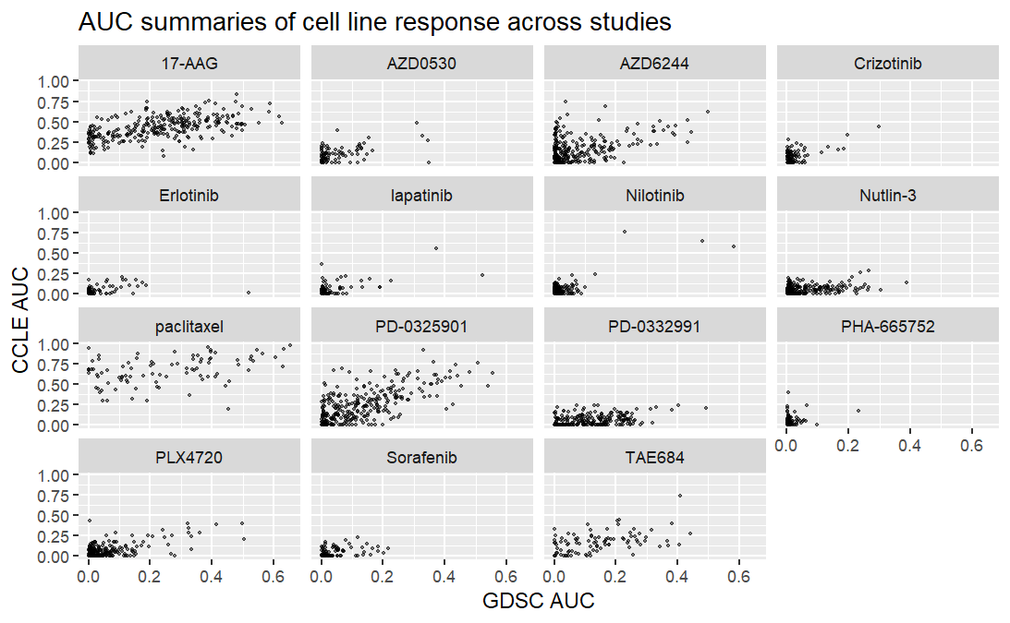
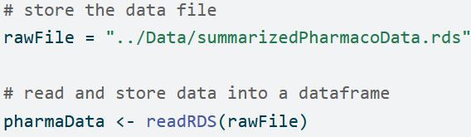
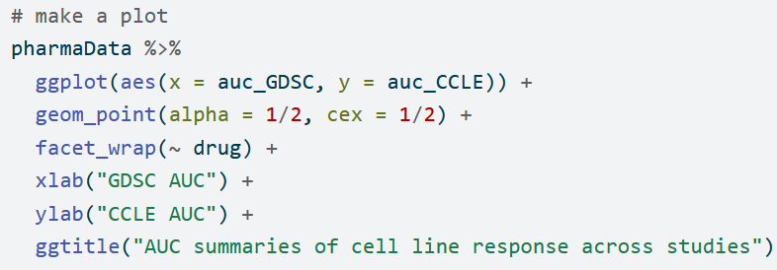

Slide 6
2. Pearson and Spearman correlation coefficients of the AUC in GDSC and CCLE for each drug

Slide 7
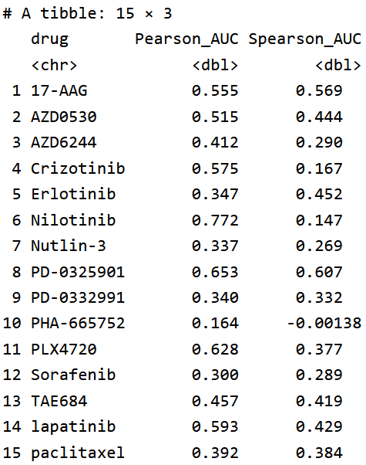
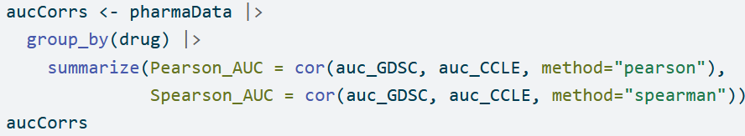

Slide 8
3. Based on the scatterplot and correlation values for AUC, would you say that GDSC and CCLE tend to agree? Why or why not?

Slide 9
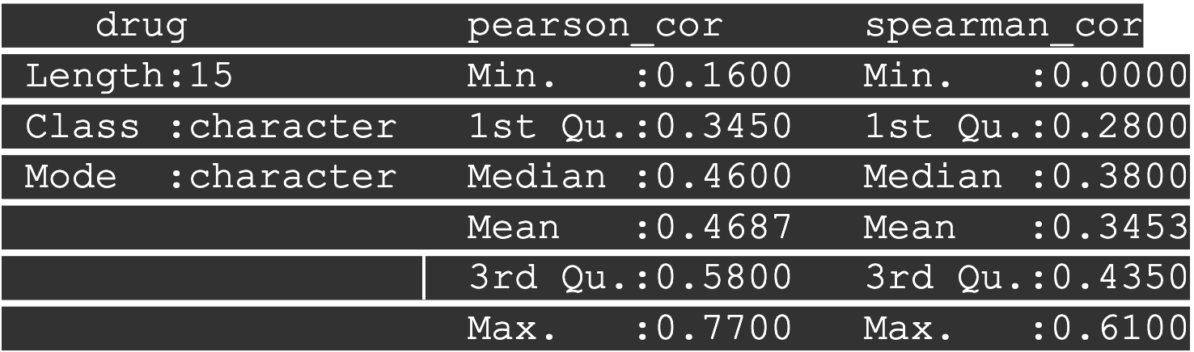
Analysis of correlation coefficients
In general, the GDSC and CCLE studies only seem to be moderately correlated. The mean and median values for both studies correlation coefficients are all below 0.5.
Additionally, several of the individual drugs have coefficients above 0.5, but many more are below.
p-value: 0.0216
t-statistic: 2.598
Notes:
If we were to use the Pearson Correlation Coefficient average between the drugs (0.469), it would point towards a moderate linear relationship between GDSC and CCLE.
The 2 samples t-test ran got a p-value of: 0.0216. Which indicated a significant difference between the values of GDSC and CCLE. A t-statistic of 2 por encima es statistically significant.
When we look at all the values of both drugs, take their average, and compare them, we can conclude that there is a moderate relationship between the values and they tend to agree. However, when looking at each sample in detail, we observe discrepancies in the correlation between the drugs. This leads us to understand that we cannot compare the samples as a whole; rather, each one must be examined individually. Through this analysis, we can conclude that in most samples, there is not a valid correlation between both studies.

Slide 10

4. Do the Pearson and Spearman correlation coefficients that you calculated differ? Which do you think is a better summary of the consistency between the two studies?

Slide 11
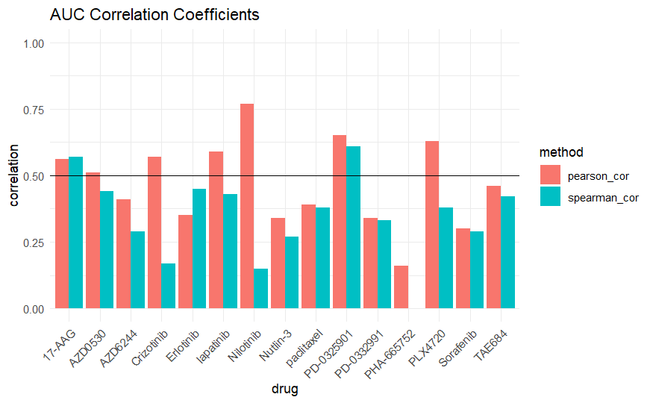
Yes, the Pearson and Spearman correlation coefficients we calculated differ. Many of the Pearson and Spearman correlation coefficients highly differ. Although the coefficients for some of the drugs are quite similar, many of the drugs are extremely different between the two measures.
Pearson's coefficient is the one that surpasses 0.50. It contains many high values, which make the data more replicable. Based on the scatter plot, we are not primarily interested in the order and discrepancy between the values, but rather that the values fall within the same area or range.

Slide 12
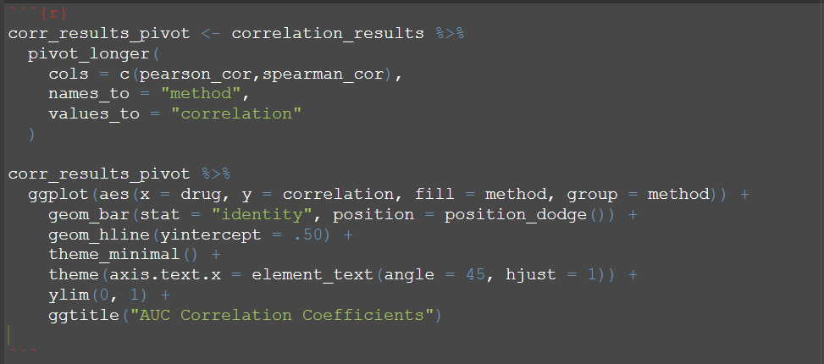

Slide 13
5. We have explored Pearson and Spearman correlation, but what about other correlation measures? For example, you could try out distance correlation, which is sensitive to nonlinear relationships.

Slide 14
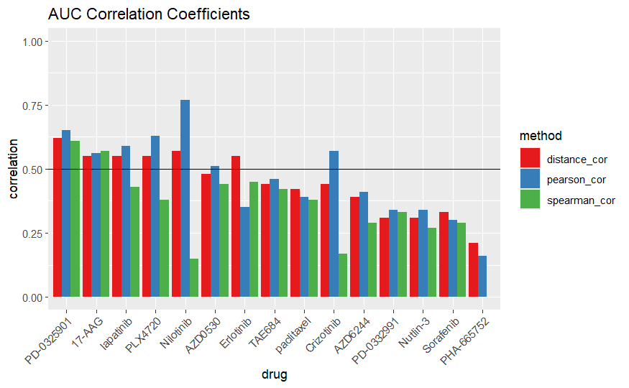
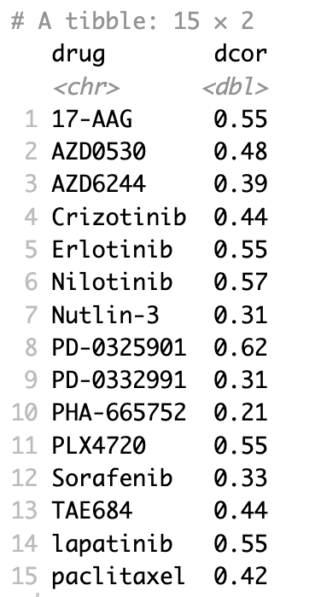
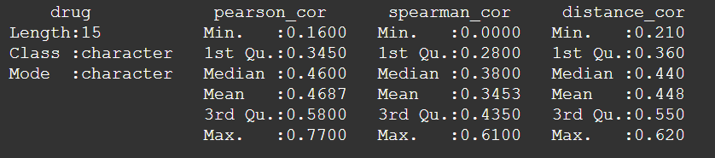

Slide 15
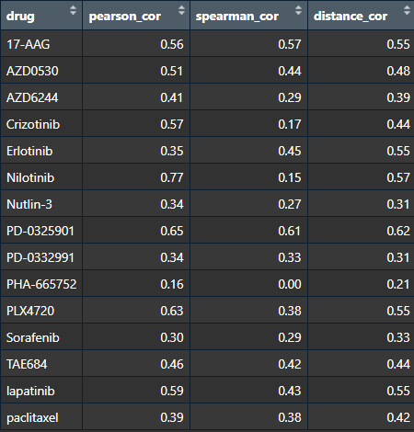

Slide 16
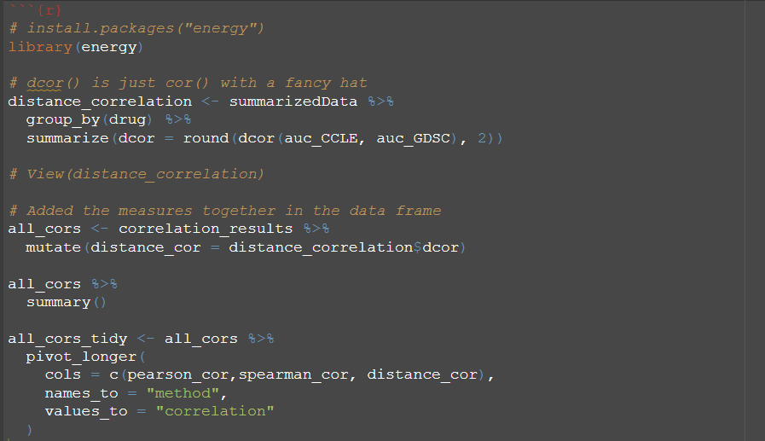
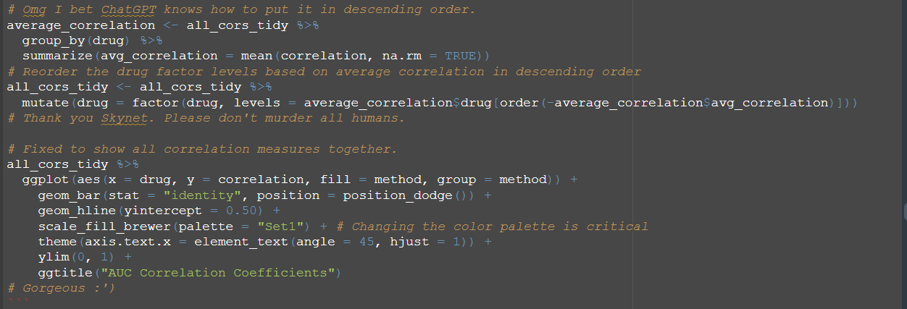

Slide 17

Thank you!

